Slide 1
Predictive Modelling of Time Series Data of Blood Glucose Concentration in Diabetic Patients using Recurrent Neural Networks (RNNs)
Abhishek Tilva
Pranay goel

Slide 2
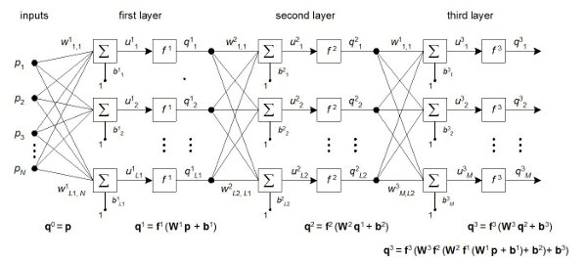
A simple feed forward network
http://www.intechopen.com/source/html/759/media/image11.jpeg

Slide 3
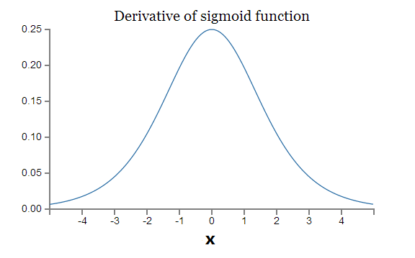
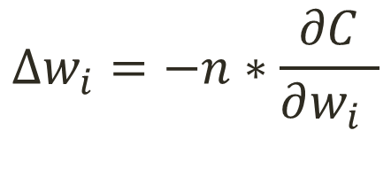
$$∆w_{i}=−n∗\frac{∂C}{∂w_{i }}$$
GRADIENT DESCENT:
Here n is the learning rate and C is the cost (objective) function.

Slide 4
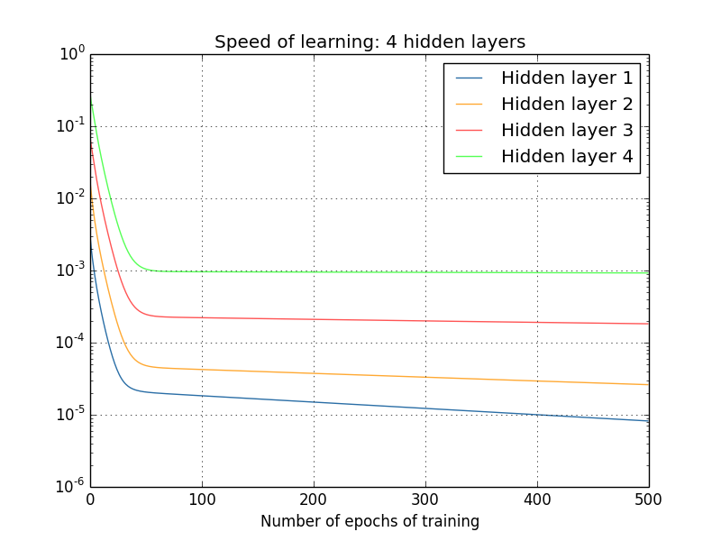
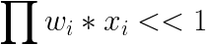
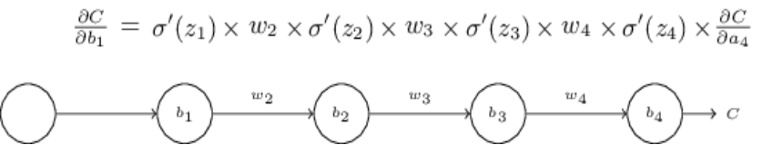
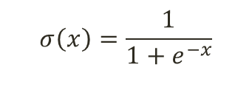
VANISHING/EXPLODING GRADIENTS IN DEEP FEED FORWARD NETS
Usually sigmoid/tanh activations are used.
$$σ\left(x\right)=\frac{1}{1+e^{−x}}$$
Derivative of sigmoid <0.25 and the most weights in the network are <1. So,
http://www.neuralnetworksanddeeplearning.com

Slide 5

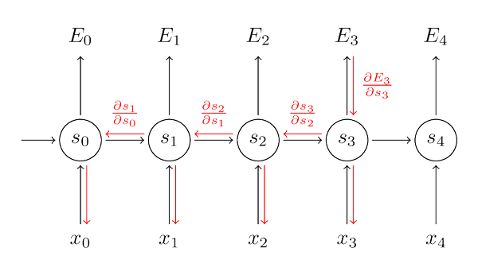
SIMPLE RECURRENT NETS WITH SELF RECURRENT LOOPS
Backpropagation Through Time
http://www.wildml.com/2015/09/recurrent-neural-networks-tutorial-part-1-introduction-to-rnns/

Slide 6
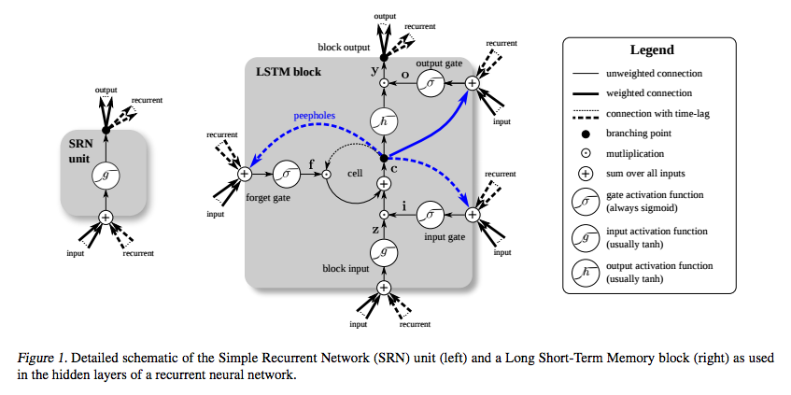
LONG SHORT TERM MEMORY (LSTM)
http://deeplearning4j.org/lstm

Slide 7


SIMPLE RNNs VS LSTM RNNs
http://colah.github.io/posts/2015-08-Understanding-LSTMs/

Slide 8


IN AN LSTM CELL
FORGET GATE
INPUT GATE
http://colah.github.io/posts/2015-08-Understanding-LSTMs/

Slide 9


IN AN LSTM CELL
OUTPUT GATE
CELL STATE
http://colah.github.io/posts/2015-08-Understanding-LSTMs/

Slide 10
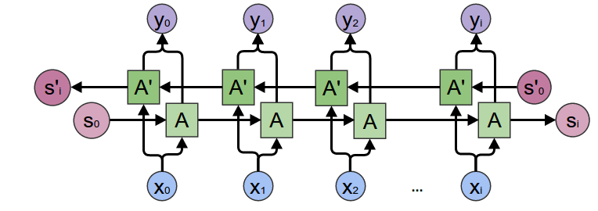
BIDIRECTIONAL RNN
Used in Google’s Speech Recognition Systems
http://colah.github.io/

Slide 11
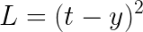
METHODS
For carrying out training time windows are used as input to the network
The network consists of an input layer, a hidden layer with LSTM units and an output layer with sigmoid/tanh/linear units
The weights and biases of the network are initialized using truncated normal
Target replication strategy [5] is used where in outputs are obtained at each time step and total error over all time steps is accumulated
The network is trained using gradient descent based optimisation methods.
For forecasting values, we train this network against the objective of minimizing total mean squared error over all samples
Error in a unit of output layer:
For multi step prediction, mainly three different approaches are used:
Train the network to predict the corresponding value directly (model-1 ) (also referred to as direct strategy)
Train the network to predict all values of the series till the required value and compare the last required value (model-2 ) (also referred to as MIMO (multiple input multiple output))
Train the network to predict only the next value and then obtain the value at required number of steps ahead in time by sequentially using the predicted value as input and reaching to the required value (model-3 ) (also referred to as recursive strategy)

Slide 12
CLASSIFIER
For the classier, if the glucose level is < 80 mg/dL, the condition represents
hypoglycemia and the corresponding output vector is set as [1,0,0]. Similarly
for glucose level between 80 and 140 mg/dL (normoglycemia), the output
vector is [0,1,0] and for > 140 mg/dL (hyperglycemia) is [0,0,1]. The output
layer is a softmax output layer which gives the probability distribution over all
the classes and the model is trained against minimizing a cross entropy loss
which is given by:
For the classification accuracy of >90% on training set, the accuracy on test data was 60-70%. This again shows overfitting of training data.

Slide 13
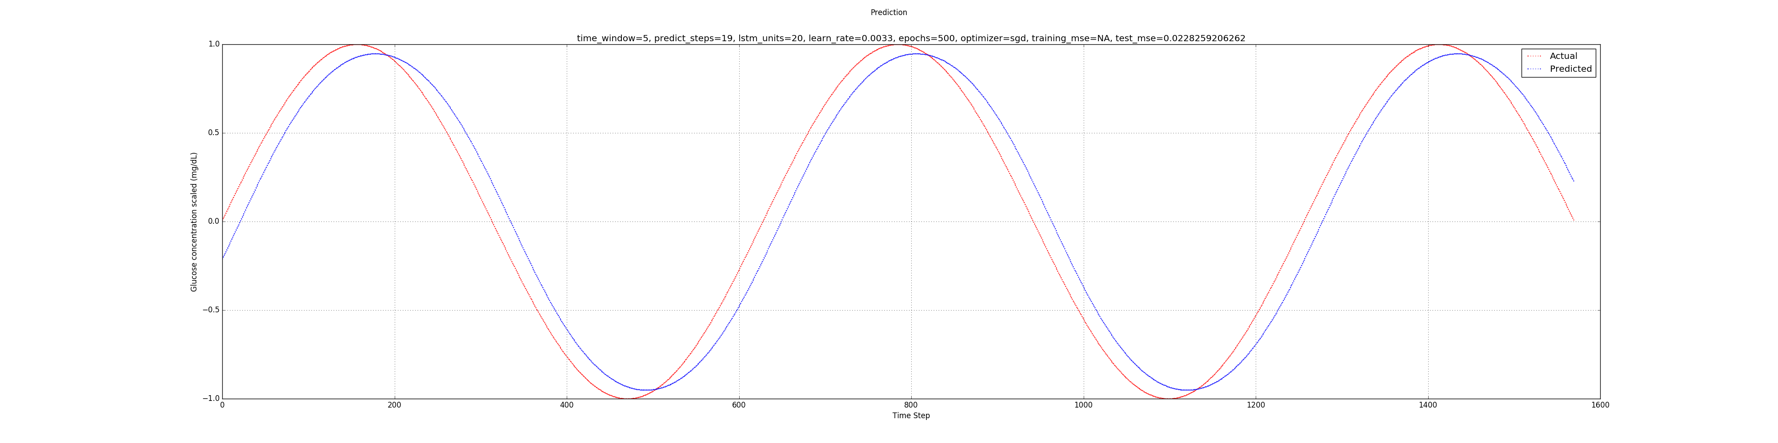
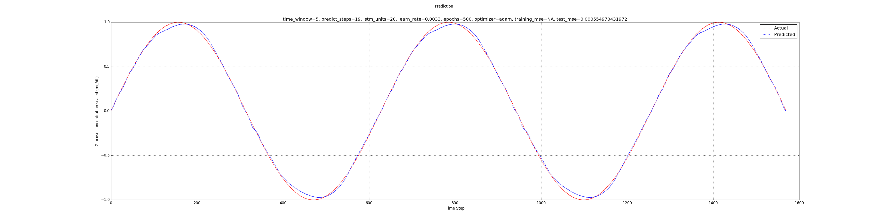
MODELLING SINE CURVE

Slide 14
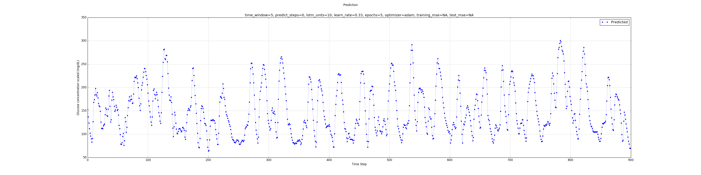
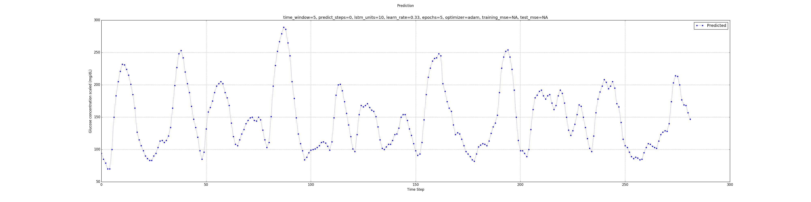
BLOOD GLUCOSE CONCENTRATION DATA

Slide 15
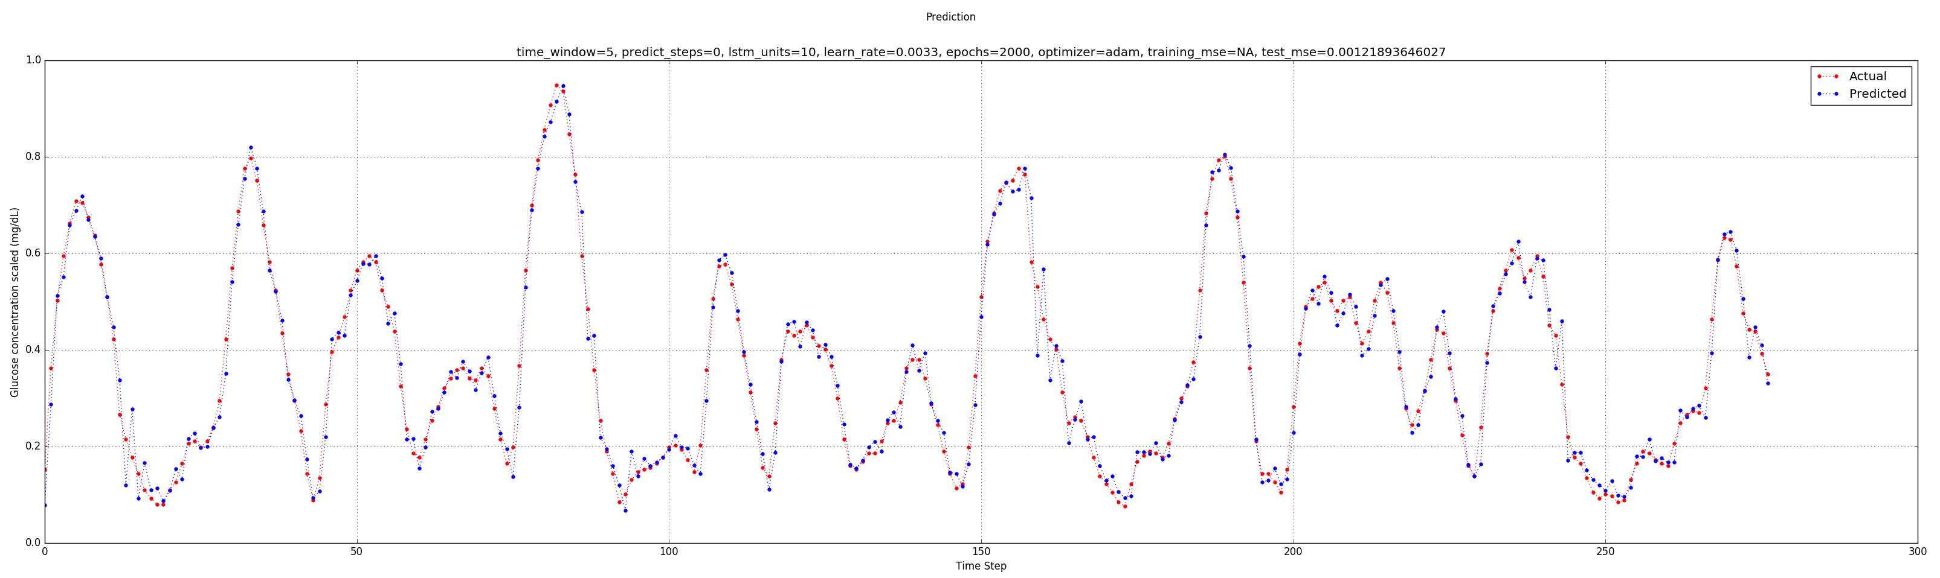
15 MINUTE AHEAD PREDICTION

Slide 16
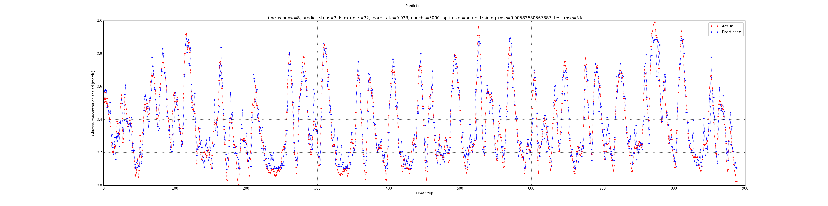
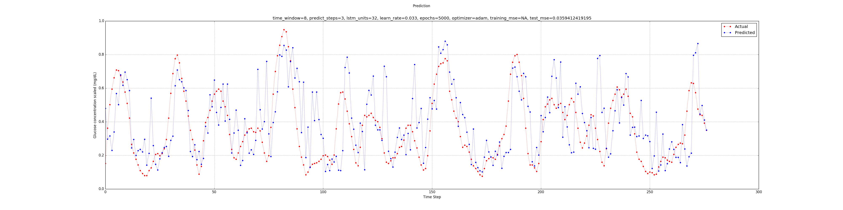
DROPOUT FOR REGULARIZATION

Slide 17
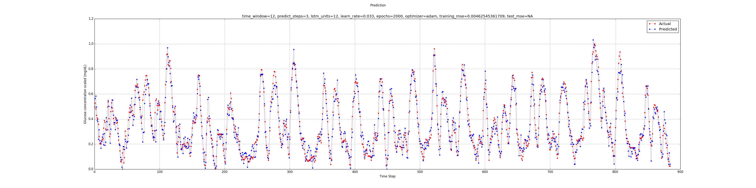
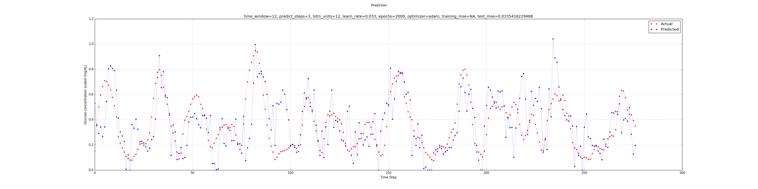
CONNECTED UNITS IN OUTPUT LAYER

Slide 18
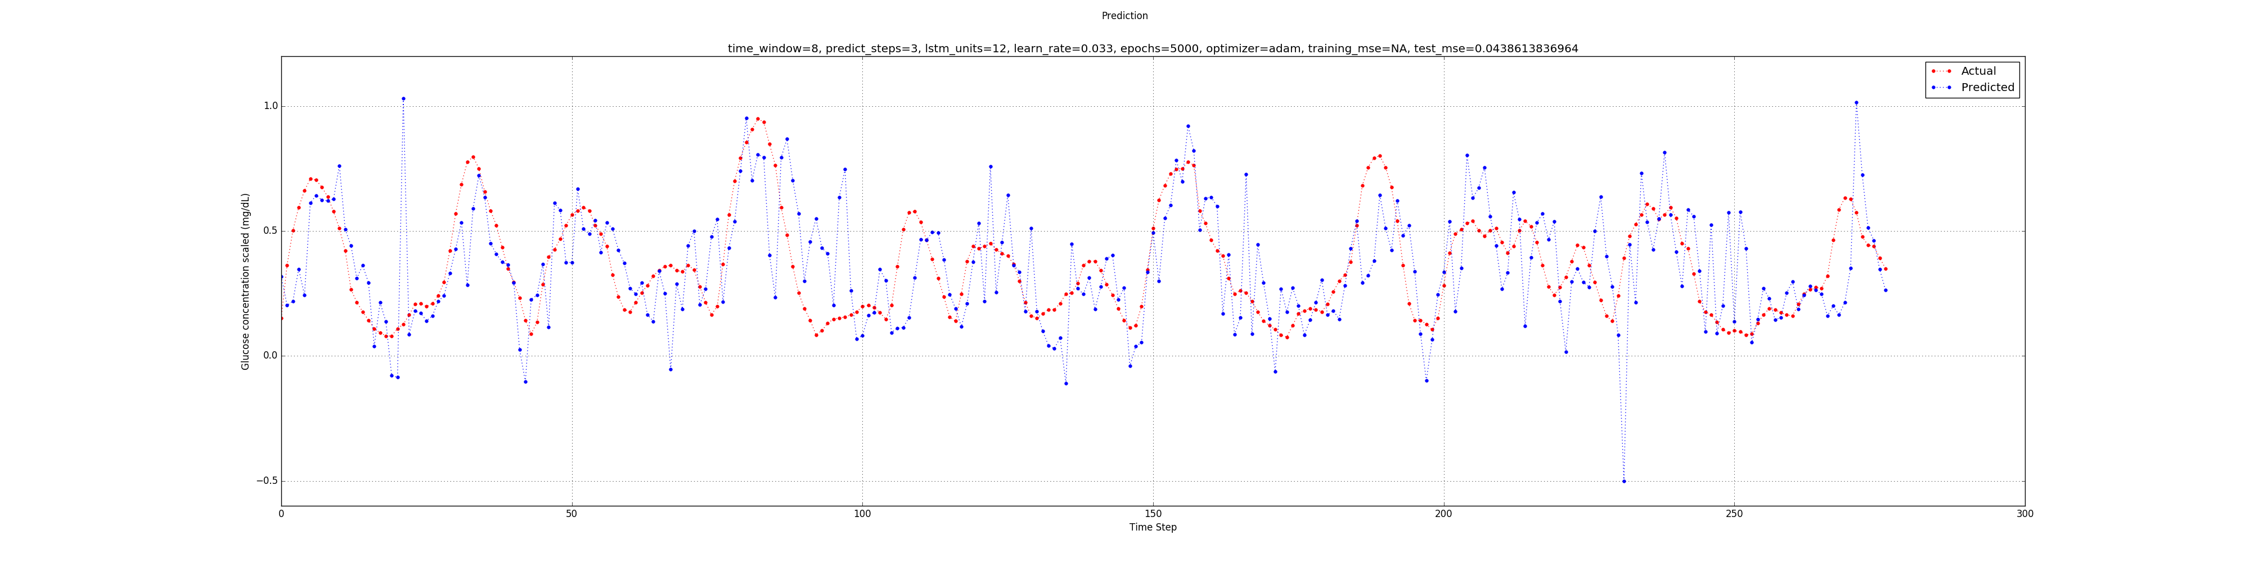
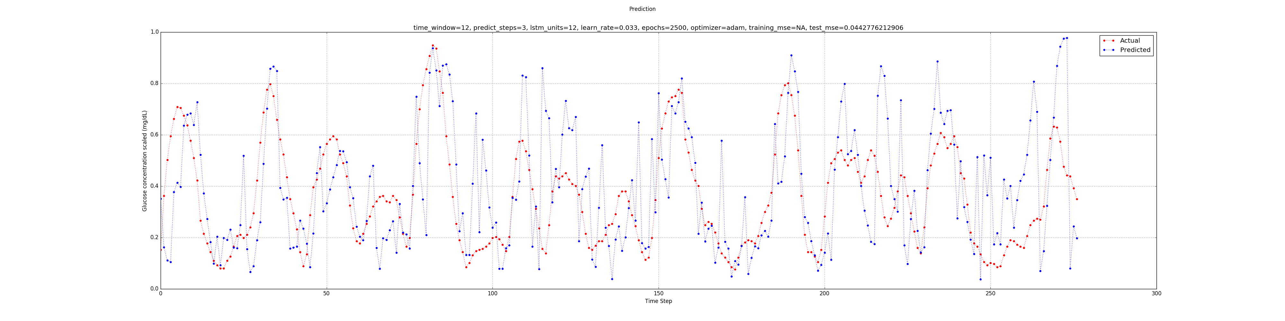
BIDIRECTIONAL RNN AND USING 24 HOUR PRIOR WINDOW AS INPUTS

Slide 19
CONCLUSION
One of the main reasons which I suspect for the failure of the model for multi step prediction is the small amount of data. Total number of training samples are 900 and corresponding test samples are 277. Neural network models have known to require a lot of data for training efficiently and learn a good representation of the overall process [1]. This may be the primary reason that our model does not perform well for multi step ahead forecasting. However time series forecasting in general and particularly in it the multi step ahead forecasting are very dicult problems for which no general solutions exist [6] due to increase in uncertainity as the horizon of the prediction increases.
However, here our approach had been of modelling the time series with out any preprocessing like removal of trends and deseasonalization which have potential for improvement in multi step ahead prediction [6].

Slide 20
REFERENCES
[1] Dorner, Georg. "Neural networks for time series processing." Neural Network World. 1996.
[2] Hochreiter, Sepp, and Jrgen Schmidhuber. "Long short-term memory." Neural computation 9.8 (1997): 1735-1780.
[3] Abadi, Martn, et al. "Tensorow: Large-scale machine learning on heterogeneous distributed systems." arXiv preprint arXiv:1603.04467 (2016).
[4] TFLearn: Deep learning library featuring a higher-level API for TensorFlow. http://tearn.org
[5] Lipton, Zachary C., et al. "Learning to Diagnose with LSTM Recurrent Neural Networks." arXiv preprint arXiv:1511.03677 (2015).
[6] Taieb, Souhaib Ben, et al. "A review and comparison of strategies for multi- step ahead time series forecasting based on the NN5 forecasting competition." Expert systems with applications 39.8 (2012): 7067-7083. 12
[7] Kingma, Diederik, and Jimmy Ba. "Adam: A method for stochastic optimization." arXiv preprint arXiv:1412.6980 (2014).
[8] Srivastava, Nitish, et al. "Dropout: a simple way to prevent neural networks from overfitting." Journal of Machine Learning Research 15.1 (2014): 1929- 1958.
[9] Lu, Yinghui, et al. "Predicting human subcutaneous glucose concentration in real time: a universal data-driven approach." 2011 Annual International Conference of the IEEE Engineering in Medicine and Biology Society. IEEE, 2011.
[10] Prasad, Sharat C., and Piyush Prasad. "Deep Recurrent Neural Networks for Time Series Prediction." arXiv preprint arXiv:1407.5949 (2014).
[11] Bon, Romuald, and Hubert Cardot. "Advanced Methods for Time Series Prediction Using Recurrent Neural Network .“ Recurrent Neural Networks for Temporal Data Processing (2011): 15-36.
[12] Graves, Alex. "Neural Networks." Supervised Sequence Labelling with Recurrent Neural Networks. Springer Berlin Heidelberg, 2012. 15-35.
[13] Christopher Olah -Understanding LSTM Networks
http://colah.github.io/posts/2015-08-Understanding- LSTMs/
[14] Guo, Jiang. "Backpropagation through time." Unpubl. ms., Harbin Institute of Technology (2013).
[15] Gers, Felix A., Douglas Eck, and Jrgen Schmidhuber. "Applying LSTM to time series predictable through time-window approaches." International Conference on Articial Neural Networks. Springer Berlin Heidelberg, 2001.

